Slide 1
Product Demand Prediction
name - Sugandh kumar Sinha
batch - 8161

Slide 2
Product Demand Prediction
Objective - Product Demand Prediction with Machine Learning.
Steps
Cleaning and Analyzing Data
Predict the Product Demand (Decision Tree Regressor )

Slide 3
Cleaning and Analyzing Data
Getting Data set
Read Data set
Check null data
Relationship between the price and the demand for the product(scatter)

Slide 4
Null Value Checking and Removing
Check full data information
Check the null values using isnull
Drop the row if any null values present
Check again null values

Slide 5
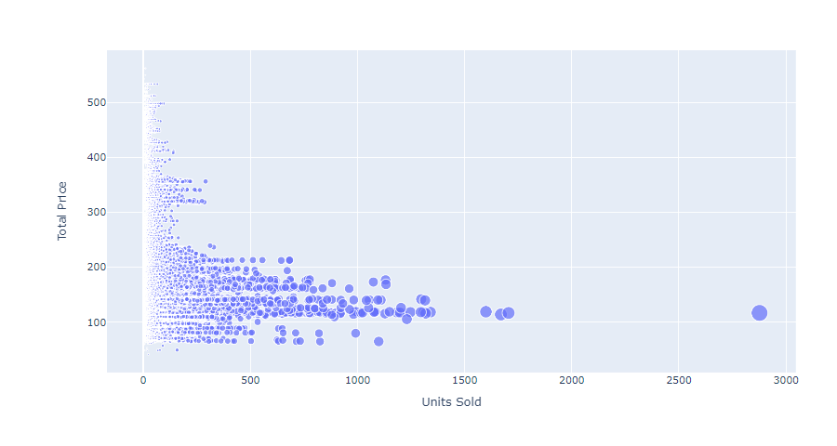
Price vs Demand product(scatter)
We can see that most of the data points show the sales of the product is increasing as the price is decreasing with some exceptions

Slide 6
Predict the Product Demand (Decision Tree Regressor )
xtrain = Total Price,Base Price
ytrain = Units Sold
Demand Predict syntax ( features = Total Price, Base Price )
features = np.array([[173.85, 192.375]])
Result : Demand Quantity is 214

Slide 7
Thank You

